Slide 1
Listening -
A Responsibility

Slide 2
Steps in the Listening Process
1 | Hearing | the physical activity
2 | Interpreting | correct decoding
3 | Understanding | clarity of content
4 | Evaluating | making judgments
5 | Responding | feedback to the speaker

Slide 3
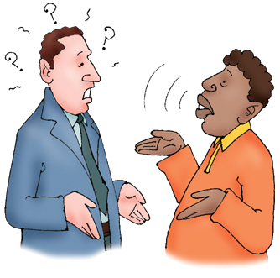
LISTENING
• Active Listening ensures proper communication
• Two actions to show listening
  Sounds of Silence
  Repeat and Reply
• Listening is a skill that can be learnt

Slide 4
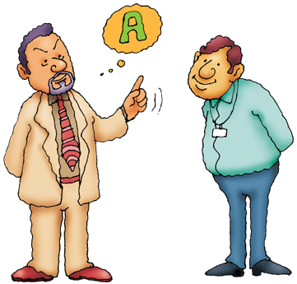
Active Listener
• Faces the speaker with a forward lean
• Maintains eye contact
• Is relaxed
• Uses prompts to encourage the speaker like
  Nods the head
  Uses sounds like yes or okay
  Asks occasional questions
  Makes proper facial expressions

